Slide 1
Future-proof technologies for secure digital societies.
Notes:
Choose, which introslide colour scheme to use.

Slide 2
Future-proof technologies for secure digital societies.
Notes:
Choose, which introslide colour scheme to use.

Slide 3
Essential facts
Architects of the
e-Estonia Ecosystem
Roots in academia
since 1960
200 employees (11% PhD)
Established
in 1997

Slide 4
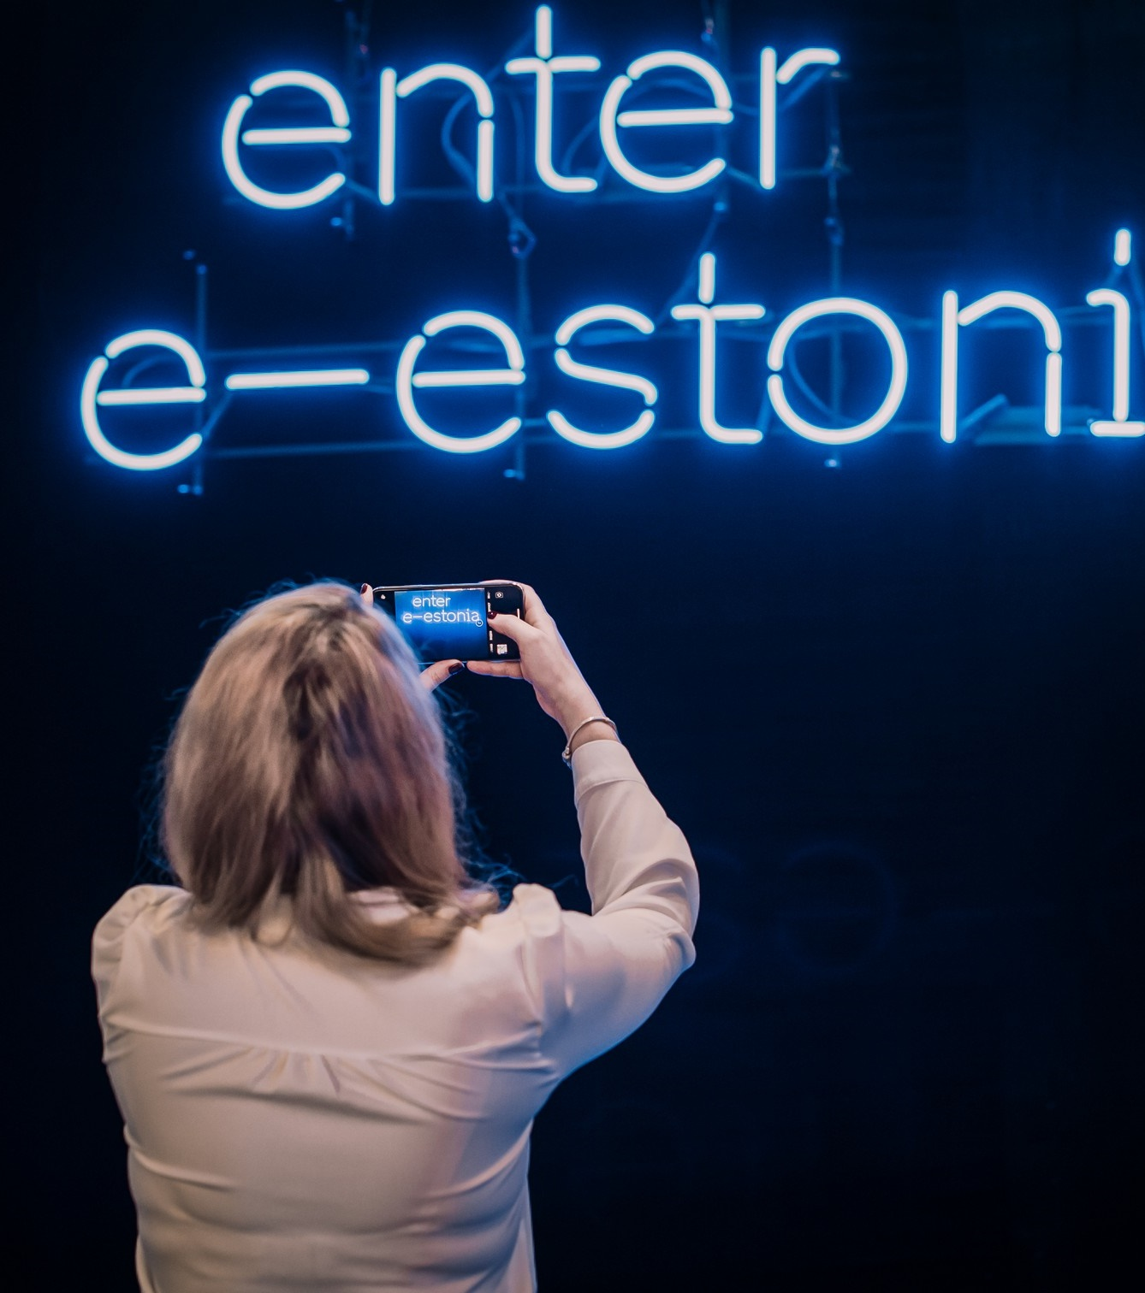
Architects of
the e-Estonia ecosystem
Estonia is known as the world’s most advanced digital society.
Cybernetica has been a key partner in developing the e-governance solutions, providing both research and practical applications for secure digital services.
Notes:
Talking points: Today Estonia is known as the world’s most digital society - 99% of government services are available online, before the Covid pandemic there were only 3 things that you couldn’t do online in Estonia (marriage, divorce and real estate transactions). Now only the first two remain.
The ascent towards digitalisation started after regaining independence in 1991. There were many factors like a young government (the prime minister was in his thirties at the time with young advisors, one of whom was also our previous president Kersti Kaljulaid), promoting computer awareness and education, and no legacy systems and a clear goal of not reusing anyone’s old tech.
Cybernetica has been a strategic partner to the Estonian state already since the 90s, developing mission critical services like i-voting, Tax and Customs systems, projects in homeland security. We have also done research and provided various reports for the government, and were part of the creation of the Digital Signature Act. While there are a couple of other companies in Estonia that have worked as closely with the state for nearly as long as we have - and they might have differing opinions :) - but we’d like to think that around 80% of the original e-Estonia innovation has come from Cybernetica.

Slide 5
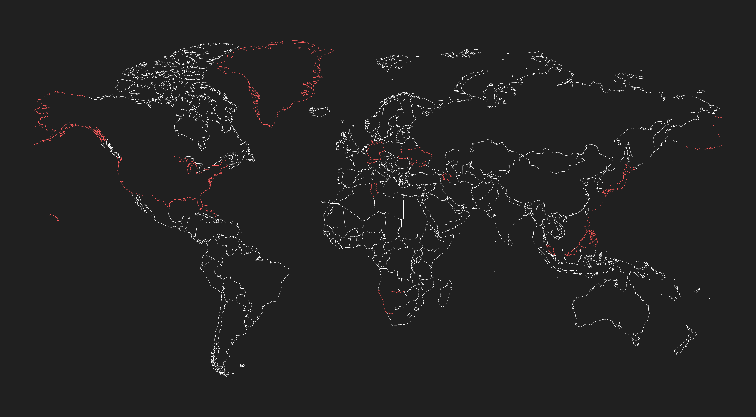
Research & Development
Clients in 35+ countries
USA
Malaysia
Tunisia
Ukraine
Japan
Namibia
Greenland
Azerbaijan
Switzerland
Bahama
Germany
and many more!
Notes:
While Estonia has been and continues to be a strong case study for Cybernetica, it is in fact just one case study among many. Today, our technologies are used in more than 35 countries around the world from Ukraine to USA and a number of exotic locations. While not quite true, there has been a running joke that Cybernetica chooses projects only in countries that have nice warm weather :)

Slide 6
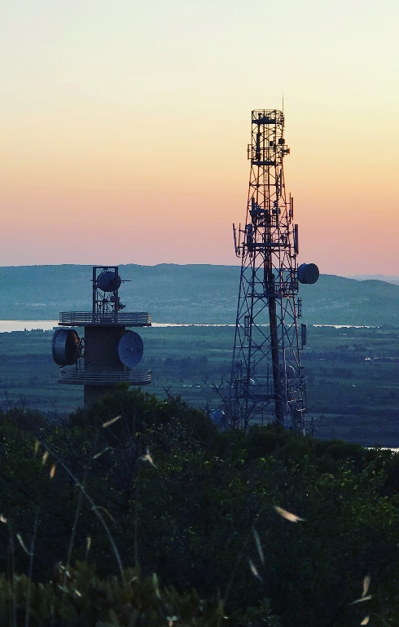
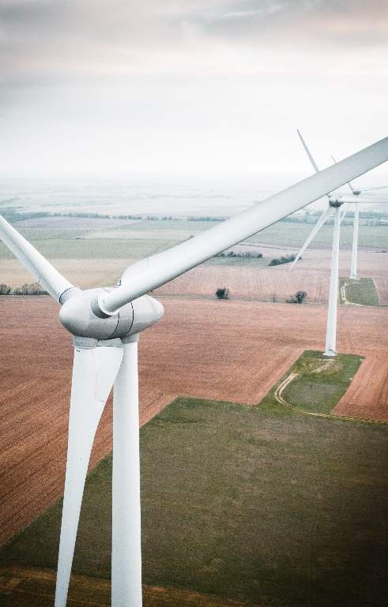
Industries
Government
Enterprise
Defence
Healthcare
Energy
Notes:
While we operate in many different sectors, most of our customers are either governments or government agencies. Probably roughly 80% of our customer portfolio is B2G and the remaining bit B2B, we provide the technology for the service provider that interacts with the end user. (For example, even in the case of i-voting in Estonia, the service provider for the end users is the government.)

Slide 7
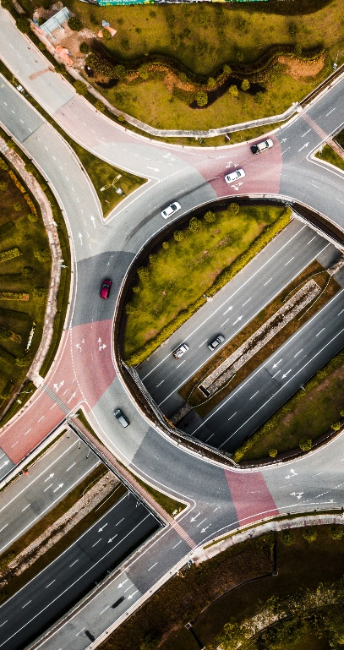
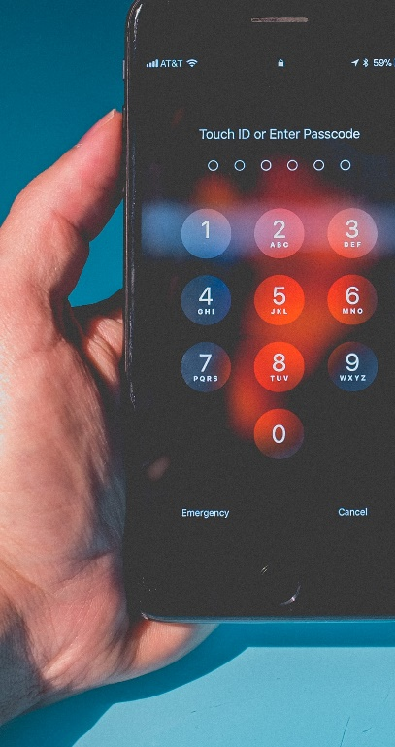
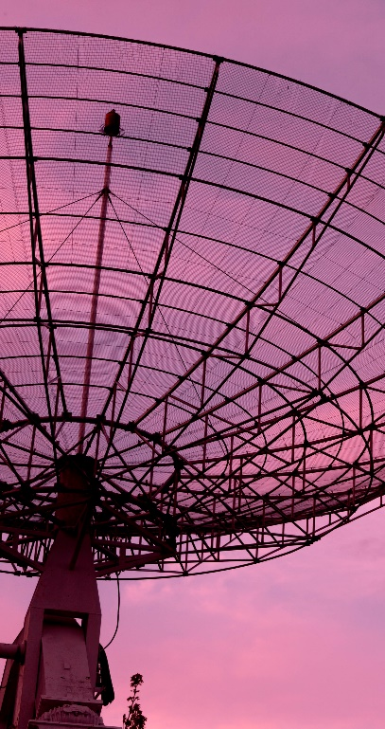
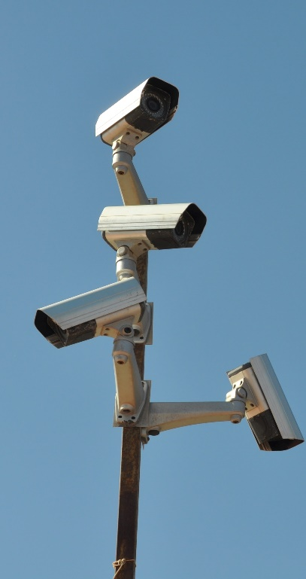
Solutions
Privacy enhance-ment
Digital identity
Inter-operability
Cyber-security
Naval awareness
Border surveillance

Slide 8
In-house research institute
Cryptography
Artificial Intelligence
Secure Multiparty Computation
Cybernetica focuses on research and development in information security with its Institute of Information Security.
It is collaborating with top universities and research facilities around the world and has conducted projects for NATO, DARPA, EU.
Information security
Crypto Algorithm Lifecycle Reports
Notes:
Close cooperation with institutes, centres of excellence, and partners from the EU, US, and Japan.
Our in-house research institute is an accredited research institution that competes for research funding just like universities do. We produce world class research into many areas, for example:
*information security: Construction of efficient security protocols.
*Security protocols: Computationally secure information flow in programs and sound analysis of cryptographic protocols.
*Cryptography: In-depth research on public key infrastructure (PKI) and complexity-theoretic foundations of cryptography.
We also produce research that directly supports our product and business development, which is also why we can confidently say that our product and technologies do exactly what we promise.

Slide 9
Experienced in large-scale projects
Estonia
Global
Baltics
UAE
Interoperability in Ukraine, Japan, Namibia, the Caribbean and more
Secure digital identity with 3M active users and 75M transactions monthly
Marine communications for Jebel Ali, the 9th largest port in the world
The first national internet voting solution in the world
Notes:
Internet voting in Estonia is not the same what the world knows as electronic voting.

Slide 10
Architects of the e-Estonia ecosystem
1998
2000
2001
2004
2005
Time stamping
Digital Signature Act
X-Road
eCustoms for joining the EU
Internet voting
Notes:
*Time stamping is today used, for example, as part of our electronic identity infrastructure for verifying digital signatures.
*Estonia started issuing digital identity in the form of an ID-card in 2002. The first digital signature in Estonia was also given in 2002. Laws like the Digital Signature Act paved the way for the widespread use of digital identity in Estonia (and as we know digital identity is also one of the foundational pillars of digital societies).
*X-Road is the Estonian national data exchange layer that connects various public and private sector services for the convenience of the citizen and benefit of the state. The X-Road handles around 200 million queries per month, of which around 3% are generated by a human, the rest are fully automated procedures. The X-Road saves around 2391 years of working time per year.
Cybernetica was part of the original team creating the X-Road and we were closely connected to the maintenance until the development of the national X-Road was fully given to the appropriate government agency. However, based on this experience we have developed our Unified eXchange Platform data exchange solution.
*We have been working with the Estonian Tax and Customs Board already since the early 2000s. When Estonia joined the EU (and NATO) in 2004, we helped prepare the Tax and Customs systems according to applicable EU law and we have been further developing the Estonian Tax and Customs systems since then.
*Estonia was the first nation state in the world to allow internet voting.

Slide 11
Architects of the e-Estonia ecosystem
2006
2009
2011
2014
2014
Piloting Sharemind privacy preserving technology
Estonian blue border surveillance
Strategic alliance on cryptographic security with DARPA
UXP secure data exchange
National GMDSS system
Notes:
*Sharemind is a technology that allows the analysis of confidential data without compromising data privacy nor compliance with appropriate laws. Sharemind was originally researched by Dan Bogdanov, our Chief Scientific Officer, as his PhD.
*Strengthening the surveillance capacity for Estonian water borders.
*Cybernetica has produced research for DARPA since 2011 in the field of privacy technologies. Current collaboration focuses on zero-knowledge proofs and application for handling sensitive data in government interactions.
*In 2014 we created a product called UXP based on the aforementioned Estonian X-Road.
*Global Maritime Distress and Safety System for Estonia.

Slide 12
Architects of the e-Estonia ecosystem
2017
2018
2019
2020
2021
SplitKey mobile identity
Estfeed Smart Grid platform
Remote air traffic control with Estonian Air Navigation Services
Cyber threat intelligence platform between Estonia and US
Consent management for UXP
Notes:
*In 2017 we launched Splitkey, which can turn any smart device into a secure authentication and qualified digital signature device. This technology is also used within the Smart-ID service all over the Baltics.
*In 2018 we developed the Estfeed platform for the Estonian company, which is owned by the state, that maintains the electrical networks across the country. The platform aggregates data from energy companies and service providers, and allows secure access and management of the data, helping to increase efficiency in the way energy is managed.

Slide 13
Architects of the e-Estonia ecosystem
2022
2022
Sale of Remote Tower to Adacel
Managed UXP interoperability as a service

Slide 14
Digital identity
Next generation mobile digital identity with unbreakable security.

Slide 15
Digital Identity Splitkey
Tokenless mobile digital identity that can turn any smart device into secure authentication & qualified signature device.
Secure PKI cryptography with full user control over their private key.
Regulatory compliant with the EU PSD 2 and the eIDAS regulations.
Full infrastructure and service design and advisory for implementing digital identity.

Slide 16
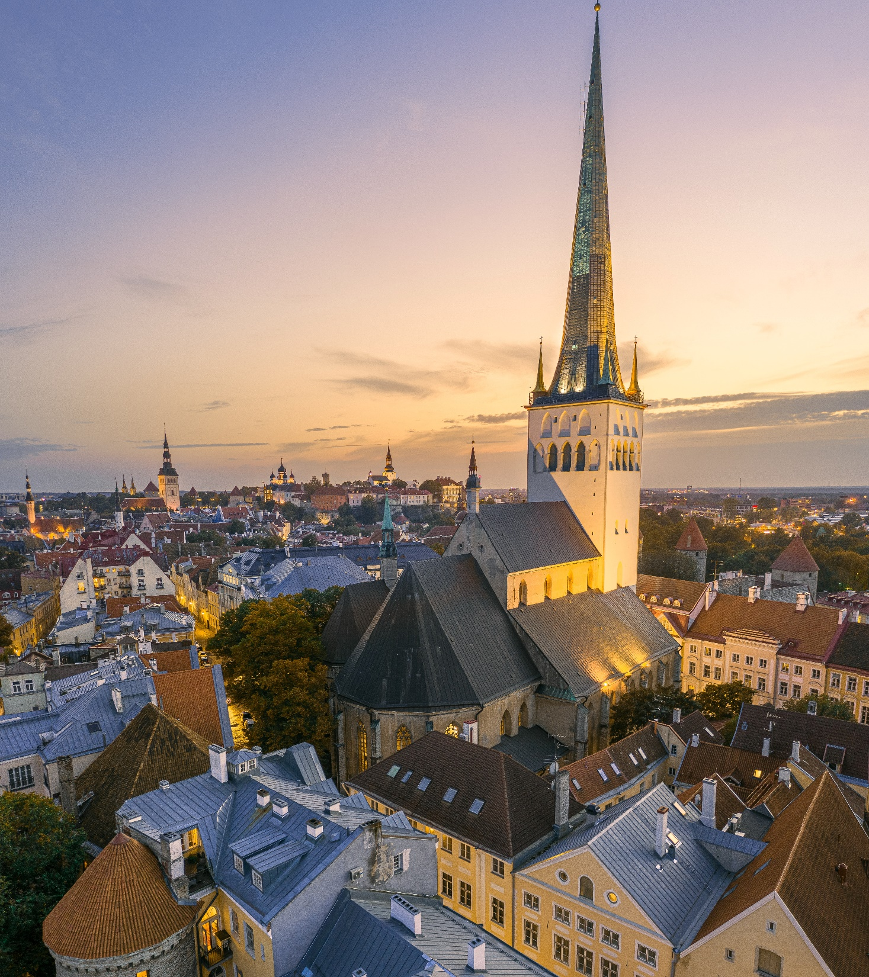
Smart-ID used in the Baltics
Cybernetica’s digital identity technology is used all over the Baltics and Iceland in collaboration with the Smart-ID service operator:
3 million monthly users & 75M transactions/month.
Used in services provided by top Nordic banks, leading telcos and e-commerce providers.
Partnership active since 2017.

Slide 17
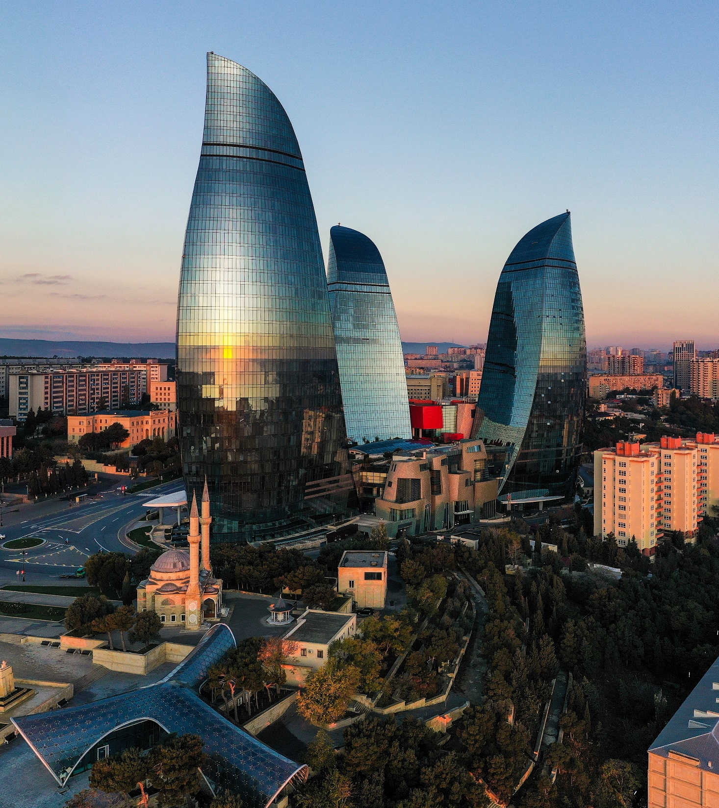
Mobile-ID for Azerbaijan
Complete e-government mobile-ID solution for the government of Azerbaijan:
Development of Certification Authority and data platform for interoperability.
All systems and services created are still in operation today.
Work completed in 2013.

Slide 18
Partnership with PWC Middle East
Digital identity strategy for the Digital Government Agency:
Elevating the Saudi digital identity with new technological opportunities.
Work on Technical Architecture, eID and Trust Services, Standards, and Legal chapters.
Partnership active since 2021.

Slide 19
Interoperability
The backbone of any successful digital transformation.

Slide 20
Interoperability via the Unified eXchange Platform
Service models include on-site traditional implementation, interoperability as a service, or a hybrid format.
We are the creator’s of Estonia’s X-road data exchange layer, one of the key components of
e-Estonia.
Service-oriented architecture within government for exchanging sensitive & time-critical data.
Trusted globally by countries big and small, and various organisations. Used by more than 60 million users.
Notes:
Ukraine, Japan, Aruba, Benin, Bahama, Namibia, Haiti, Greenland, Tunisia, Palestine, USA, NATO
Collaboration with NATO to improve interoperability capabilities via the UXP platform for the Allied Command Transformation.

Slide 21
“Cybernetica has been a leader in its sector and has demonstrated its ability to transform the Estonian state initially and then to support other territories in managing the digitalisation of public and private services.”
– Nout' Futur, La Réunion, overseas territory of France

Slide 22
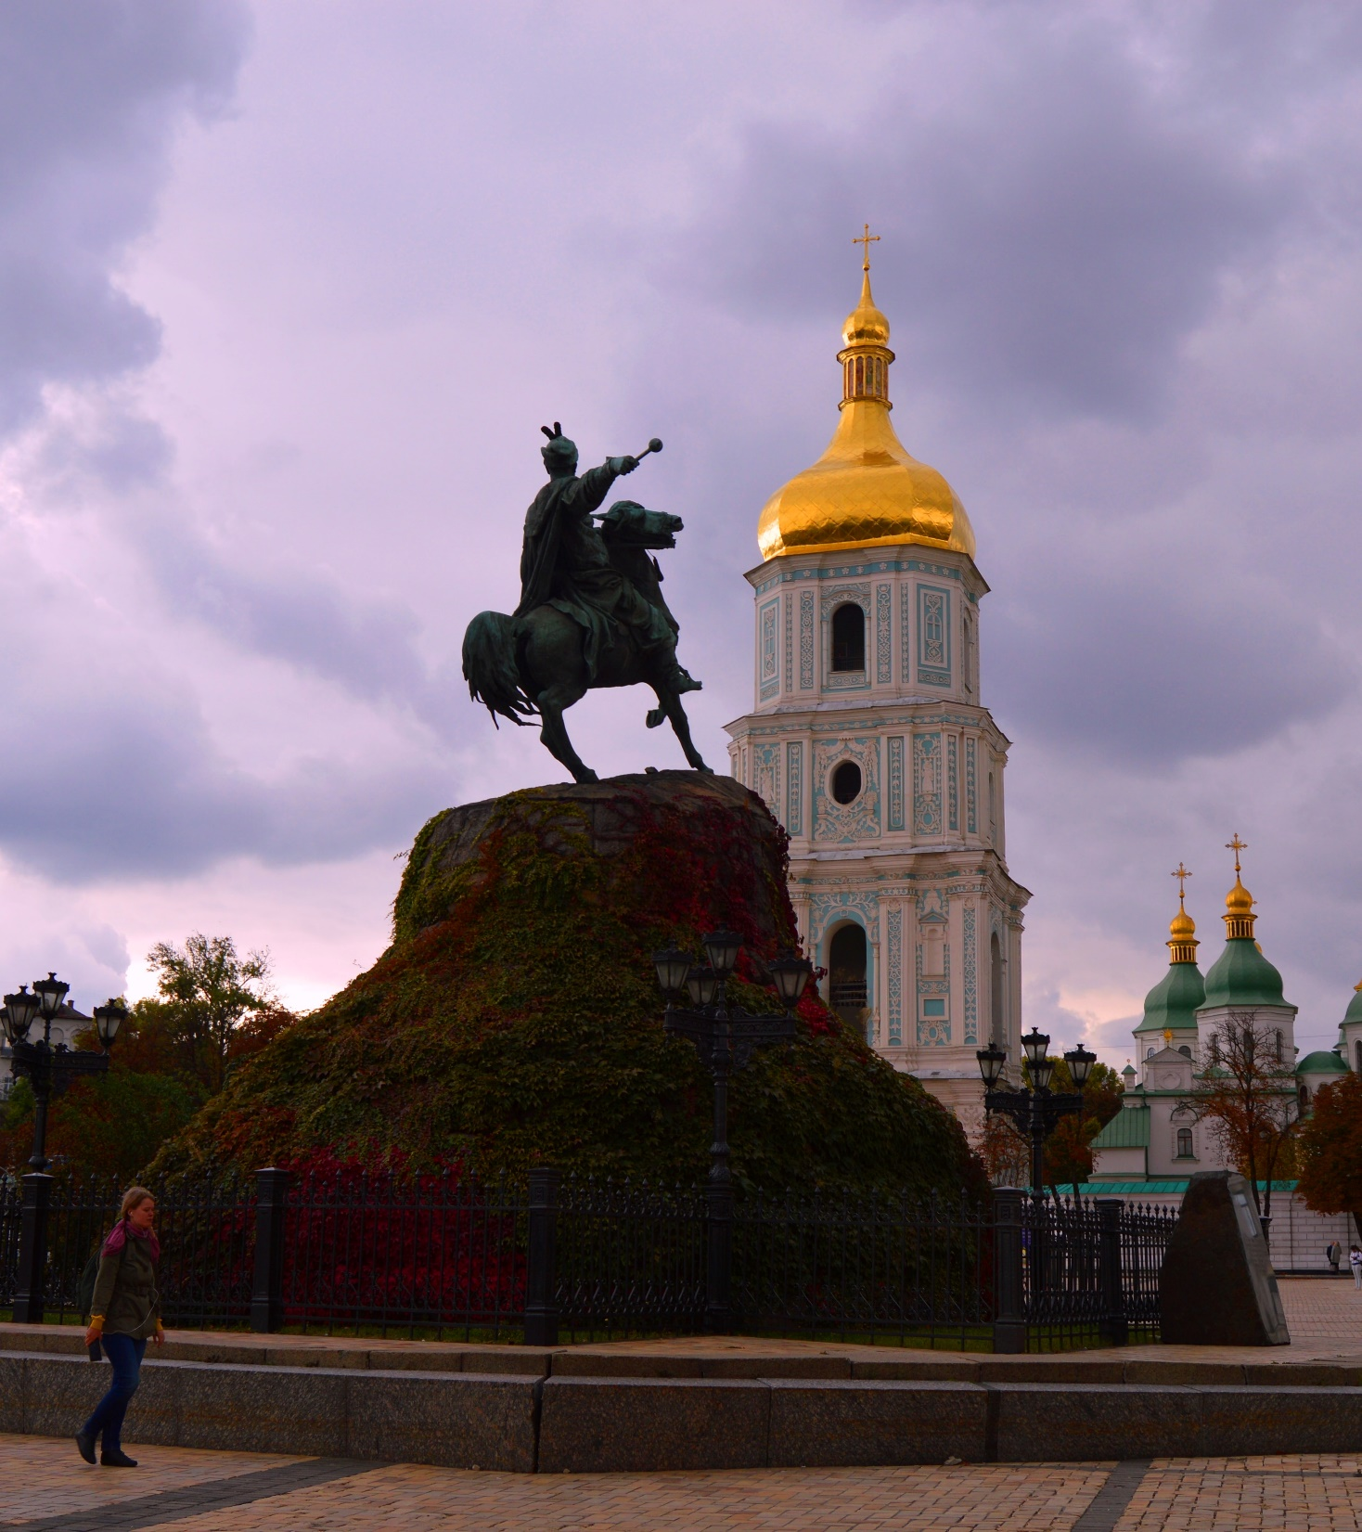
Ukraine: secure data exchange Trembita
With the population of 44.8 million, Ukraine is the largest nation-wide case study of Cybernetica’s data exchange:
Around 180 different electronic interactions and services with more than a million data exchanges monthly.
Bettering public service delivery, empowering local municipalities with e-services, reducing the number of state registers.
Partnership active since 2017.

Slide 23
Partnerships in Tunisia
Interoperability project funded by USAID and Chemonics:
Secure data exchange platform to connect 12 ministries.
Change management and stakeholder training.
Partnership active since 2019.

Slide 24
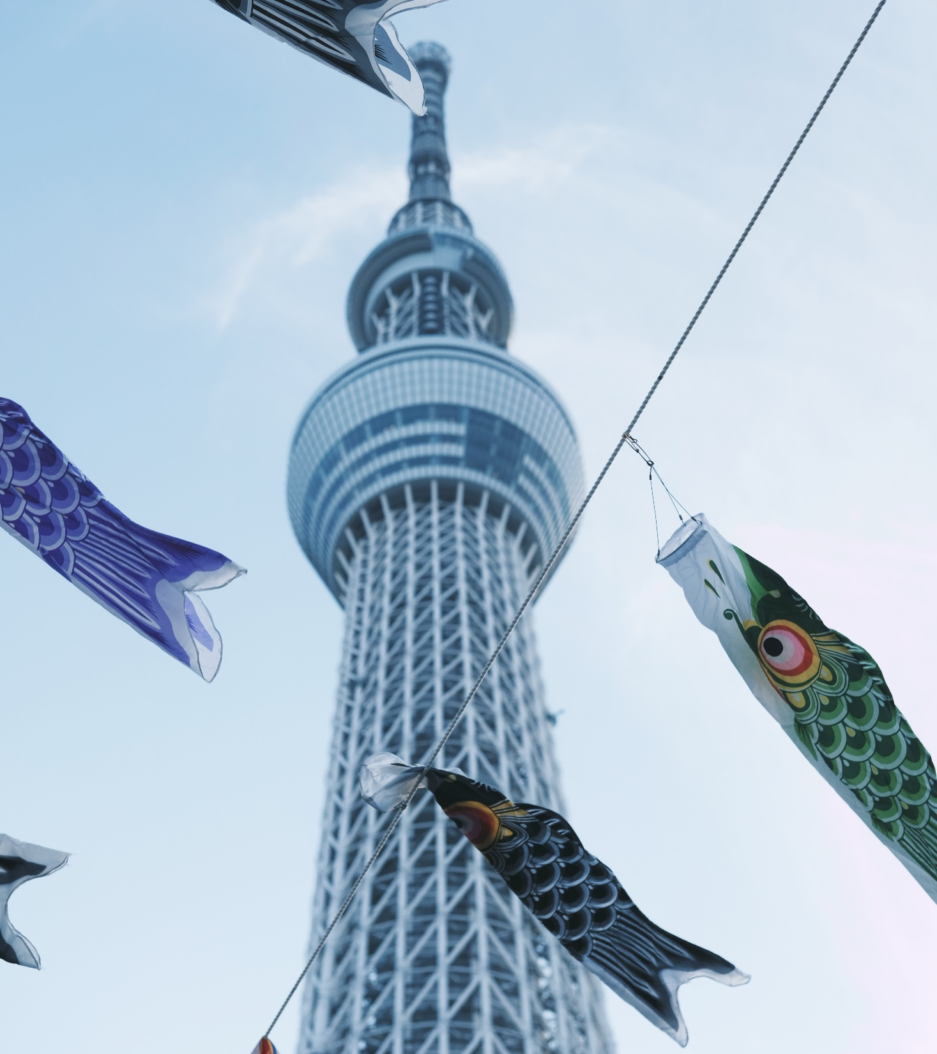
Partnership with Sumitomo Mitsui Trust Bank & NEC
Interoperability for SMTB, one of the largest trust banks in Asia, and ICT corporation NEC:
Series of PoCs to connect various public and private service providers to secure data exchange.
New and unique features such as data management for the individual.
Partnerships active since 2018.

Slide 25
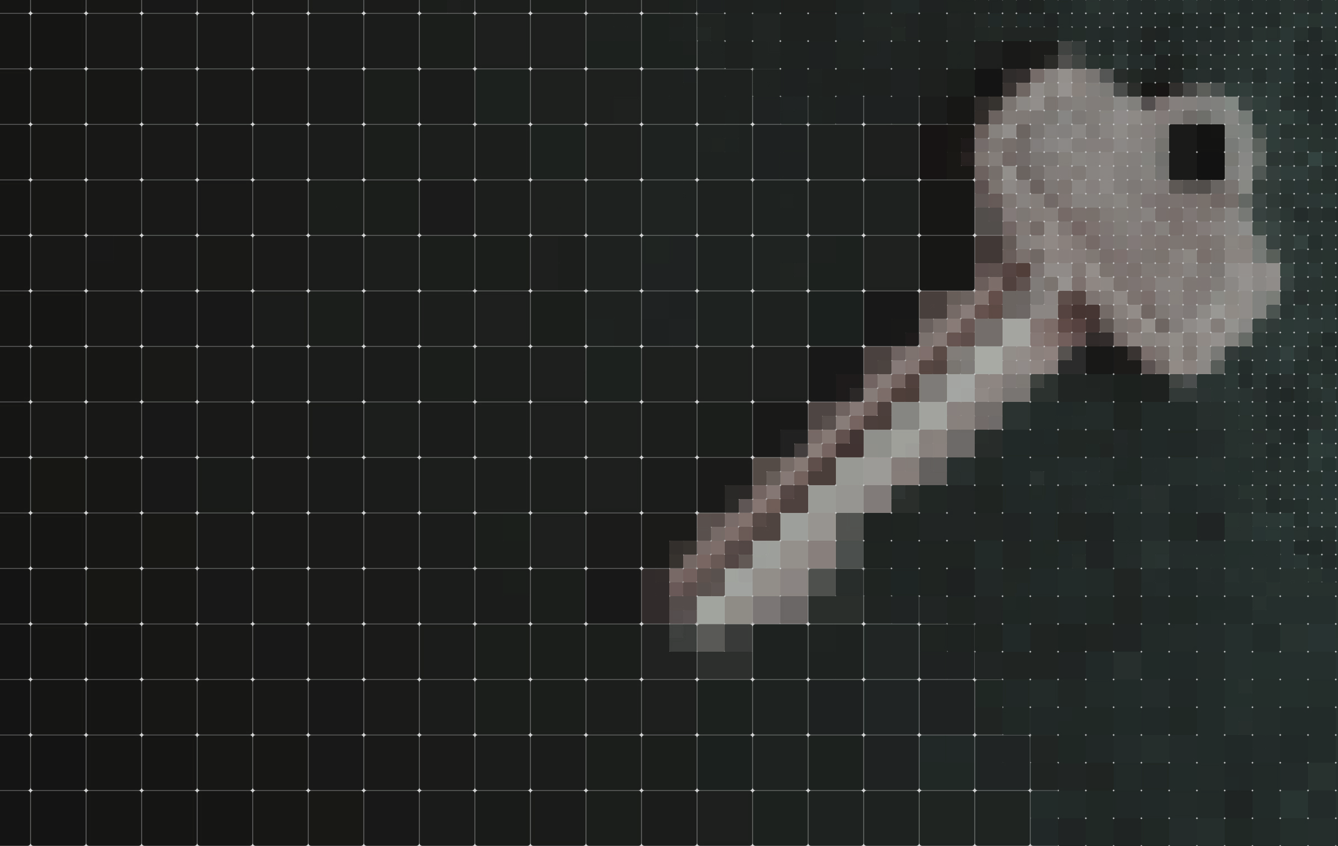
Cybersecurity
Cybersecurity ensured by experts incapable of building insecure systems.

Slide 26
Cybersecurity as a service
Security compliant with the highest standards has always been deeply ingrained in what we do.
Service portfolio includes: asset inventory, vulnerability assessment, penetration testing.
Public projects include: European cyber situational awareness platform for military end-users.
Public projects include: cyber threat intelligence sharing platform between Estonia and the USA.
Notes:
Clients in this sector prefer anonymity, which is why as of yet we have no public case studies other than the public projects mentioned.

Slide 27
Privacy enhancement
Privacy-preserving analysis of confidential datasets.

Slide 28
Privacy preserving technology Sharemind
A database and analytics system that works on encrypted data without decrypting it.
Allows linking of confidential databases, for example, for financial analytics or to prevent fraud.
Analysis of confidential data without compromising privacy.
All computations and results follow set policies and are fully auditable.
Notes:
References: Applied usecases in Estonia, Italy, Denmark, Portugal, Greece, USA, China, Switzerland, Germany, Canada, Indonesia, Norway, UK. Notably, genome data storage and querying mechanism for Sophia Genetics.
Areas of application - financial, medical

Slide 29
Proof of concept with EUROSTAT
A privacy preserving approach to computing statistics from sensitive data:
Proved the feasibility of producing statistics from mobile network operator data while preserving the anonymity of mobile phone users.
Cybernetica’s Sharemind HI was used for the research in partnership with Intel.
Project completed in 2021.

Slide 30
Surveillance and naval awareness
Situational awareness for safety at sea and effective border surveillance systems.

Slide 31
Integrated Surveillance & Navigation Systems
Border surveillance deployed on the external borders of EU and NATO, also Bulgaria, Montenegro, Romania.
Comprehensive maritime situational awareness system for identifying objects and targets.
100+ installations across the world, from South East Asia to Middle East and Europe.
Secure remote data transmissions into multifunctional control centre.
Notes:
Cybernetica builds effective border surveillance systems and smart solutions for vessel and air traffic management to improve situational awareness. Our surveillance and radio communication systems are used in over 100 locations in the world, including the external borders of the EU and NATO.
References: Indonesia, Malaysia, UAE, Singapore, Estonia, Romania, Bulgaria, Poland, Germany, Denmark, Italy, Azerbaijan, Lithuania, Montenegro.

Slide 32
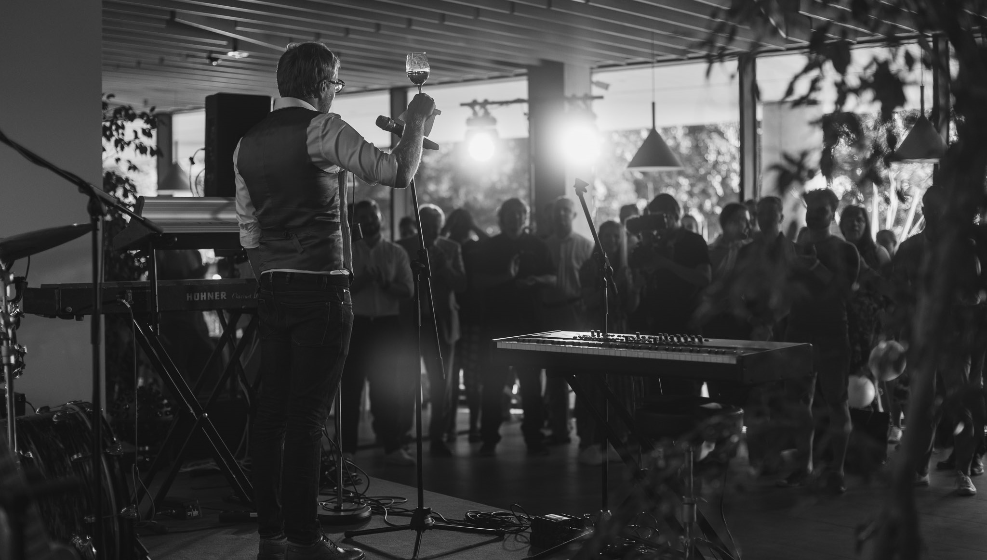
Company Culture

Slide 33
How we work
To make (digital) life better
Highest standards
Pursuit of education
“We have crafted a culture that is supportive, inclusive and equal.”
- Oliver Väärtnõu, CEO at Cybernetica
Internship programmes & scholarships
Vetting and matching values
Notes:
*200 employees, offices in Tallinn and Tartu. Representation in Japan and Morocco.
*11% employees hold a PhD
*around 30% employees are female, which is higher than the average in Estonian ICT sector - and which is roughly the same number as in Apple.
*34% of our employees are aged between 25-34, which is also the largest age demographic we have.
*Over the years we have achieved 22 awards and recognitions, among them for example the titles of best internship provider and the defence industry company of the year.
*Our ultimate goal is to help build digital societies around the world that make peoples lives better
*We support the pursuit of education - not only for our own employees but we work closely with universities in Estonia where our staff gives guest lectures and supervises theses. We also produce resources and materials for free for public use to raise awareness around information security and risk behaviours.
*While we work with many different regions around the world, we carefully vet our customers and their purposes in using our technology.
*Highest standards for our people and the work we do, for adhering to the principles of privacy and security.

Slide 34
cyber.ee
cybernetica
CyberneticaAS
cybernetica_ee
Cybernetica

Slide 35
Notes:
This is for copying icons if changes need to be made. Delete this for presenting.

