Slide 1
Future-proof technologies for secure digital societies.

Slide 2
Essential facts
Roots in academia
since 1960
Cybernetica AS established in 1997
Partnerships include
EY
PwC
European Commission
EDF
DARPA
ESA
ENISA
Technologies exported to 35+ countries, incl. USA, Japan, UAE, Ukraine, Indonesia, Malaysia
and more
Architects of
e-Estonia ecosystem
460+ research articles published since 1992

Slide 3
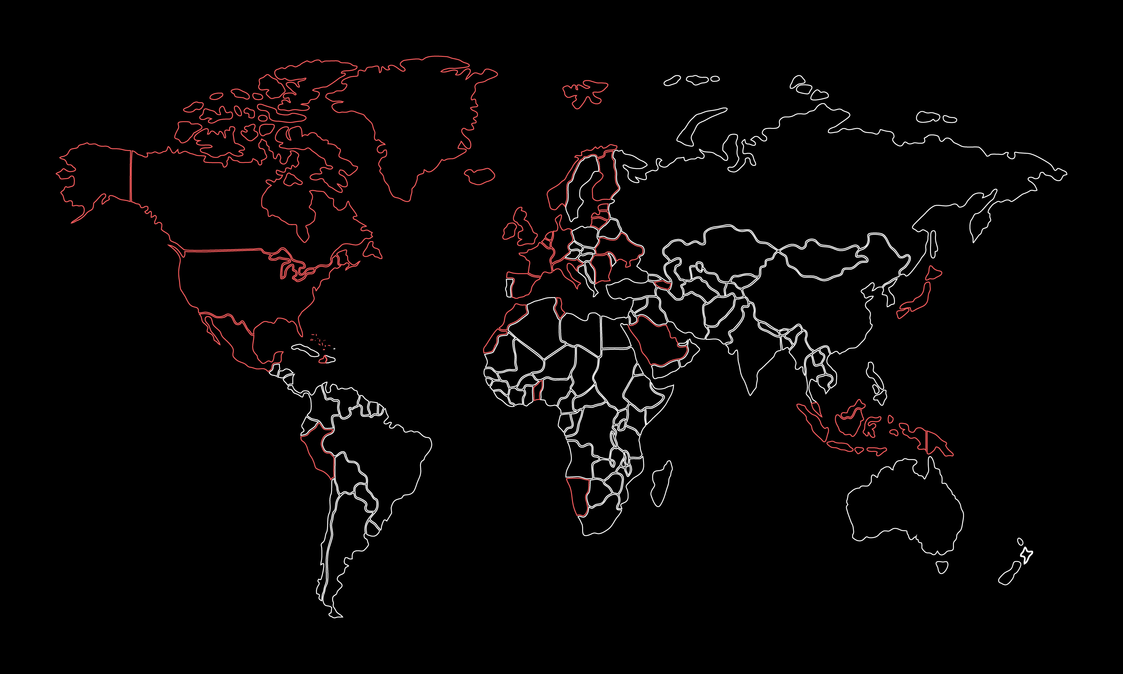
Clients in 35+ countries
USA
Malaysia
Tunisia
Ukraine
Japan
Benin
Greenland
Azerbaijan
Switzerland
Bahamas
Germany
and many more!

Slide 4
Architects of e-Estonia
Estonia is known as the world’s most advanced digital society.
Cybernetica has been a key partner in developing the world-renown e-governance solutions such as X-Road, SplitKey, e-Customs, Estfeed and more.

Slide 5
Architects of e-Estonia
1998
2000
2001
2004
2005
Time stamping
Digital Signature Act
X-Road
eCustoms for joining the EU
Internet voting

Slide 6
Architects of e-Estonia
2006
2009
2011
2014
2014
Sharemind pilot
Estonian blue border surveillance
Strategic alliance on crypto-graphic security
UXP secure data exchange
National GMDSS system

Slide 7
Architects of e-Estonia
2017
2018
2020
2022
2023
SplitKey mobile identity
Estfeed Smart Grid platform
Cyber threat intelligence platform between
Estonia
and US
Secure Digital Military Mobility
SplitKey CSP

Slide 8
Values
Integrity
Meaningful innovation
Resilient partnerships
Continuous learning
Accountability
Sustainability
Creating future technologies
Solutions with real impact
Top experts in the industry
Novel ways to execute
Turning customers into partners
Support throughout entire journey
We are delivery-oriented

Slide 9
Information Security Research Institute
R&D is in our DNA
40+ researchers
10+ PhDs
Consulting
Contractual research
Advanced projects
Teaching and training
Product and technology development
Notes:
R&D partners include DARPA, ONR, EU Commission, EDF, ESA, Estonian Research Council and Enterprise Estonia.

Slide 10
Our research domains
Digital identity
Protocol research
Privacy and AI
Cybersecurity
Our accredited Research Institute focuses on information security, cooperating with both private and public sectors.
R&D partnerships include DARPA, ONR, EU Commission, EDF, ESA, Estonian Research Council and Enterprise Estonia
Notes:
Digital identity:
Threshold cryptography
Zero knowledge proofs
Foundations of trust
Protocol research:
Internet voting
Post-quantum cryptography
Secure MPC protocols
Privacy and AI:
AI systems with end-to-end security
Synthetic data generation
Legal aspects of privacy tech
Cybersecurity:
AI-based network anomaly detection
Threat finding
Asset and threat management
Partnerships include DARPA (USA), Office of Naval Research (USA), EU Commission, European Defence Fund, Estonian Research Council and Enterprise Estonia.

Slide 11
Solutions
Digital identity
Privacy and AI
Interoperability
Tax and customs systems
Cybersecurity

Slide 12
Digital identity
Next generation mobile digital identity with unbreakable security.

Slide 13
A holistic digital identity value proposition
Technology
Product
Knowledge
Experience
Ongoing development of SplitKey products.
Three different SplitKey products for tailored digital identity needs.
Extensive knowledge of digital identity infrastructure.
Vast experience with major projects at a state level.
Notes:
Technology:
Ongoing development of SplitKey provides hardware agnostic solutions in accordance with the highest regulatory standards.
Product:
Three different SplitKey products offering smartphone based digital identity technology for secure electronic signing and authentication.
Knowledge:
In depth knowledge of digital identity infrastructure through research projects with multi- national consultancy history.
Experience:
Vast experience
with large scale projects at state level. Providing risk and security assessments, strategy and roadmaps as well as issuance procedures.

Slide 14
Digital identity offering
SplitKey
SplitKey+
SplitKey CSP
Advisory
Smartphone based digital identity technology for secure electronic signing and authentication.
Additional authentication methods for SplitKey – biometrics and pattern.
Hardware agnostic SplitKey product for digital identity wallets.
Consulting service to advise and analyse the current landscape.
Notes:
Splitkey:
Smartphone based digital identity technology for secure electronic signing and authentication.
In accordance with European Union regulation (eIDAS directive).
Splitkey+:
Additional authentication methods for SplitKey – biometrics and pattern.
Splitkey CSP:
SplitKey product for digital identity wallets to compliment the emerging European Union Digital Identity Wallet (EUDIW) ecosystem.
Advisory:
Consulting service to advise and analyse the current landscape and provide meaningful input for the digital transformation journey.

Slide 15
i-voting in Estonia
Estonia is the first, and currently, the only state in the world where citizens can elect the government online.
Population: 1.3 million
Country: Estonia
Year launched: 2005
Notes:
63,5% of governmental election votes were cast online in 2023
Local government units, state government and European Parliament

Slide 16
Smart-ID
Authentication and digital signing application utilising SplitKey technology.
Population: 6.3 million
Region: Baltics and Iceland
Year launched: 2017
Notes:
3 million users and 75 million transactions per month
Used in services provided by top Nordic banks, leading telcos and e-commerce providers

Slide 17
Partnerships
PwC
Region: Middle East
iProov
Strategic collaborations with global partners to elevate digital identity across multitude of regions worldwide.
Regions: EMEA, LATAM and APAC
EY
Regions: North Africa and Estonia
Notes:
PWC:
Digital identity strategy for the Saudi Arabian Digital Government Agency
Work on Technical Architecture, eID and Trust Services, Standards, and Legal chapters
EY
Digital Transformation partnership and consulting with EY
Providing expert analysis on Digital Identity Wallets for EU.
iProov
Multi-Factor Authentication (MFA) digital identity solution for government and financial services organisations across the EMEA, LATAM, and APAC regions

Slide 18
Collaboration with the Estonian Government
Research projects regarding the Estonian eID ecosystem and i-voting to ensure future-proof security.
Population: 1.3 million
Country: Estonia
Year started: 2000
Notes:
Estonian eID public key Single Point of Failure projects
CDOC 2.0 – new encryption protocol for ID
Internet Voting Mobile Client – mobile app to support i-Voting and m-Voting
Advisory on finding and implementing the best possible solution to bypass a possible security vulnerability with ID cards

Slide 19
The Future: Digital Identity Wallets
Strategic partnership with SK ID Solutions and the Estonian Information System Authority to scope and prepare for the development of digital identity wallets.
Year started: 2022
Country: Estonia
Notes:
SmartWallet
Collaboration with our partner SK ID Solutions to provide research and development on the wallet ecosystem and development of related solutions
Future Estonian Digital Identity Wallet (EDIW)
Collaboration with the EE Information System Authority, in designing the architecture of the future Estonian DIW and its compatibility with Estonia’s existing eID ecosystem

Slide 20
Privacy and AI
Protect data from unauthorised processing.

Slide 21
Privacy-by-Design in AI systems
Sharemind MPC
Sharemind HI
Data solutions
Advisory
The Application Server provides an API for implementing privacy-preserving services using Trusted Execution Environments.
The next generation of data-driven services with end-to-end data protection and accountability.
+ Synthetic data
+ Differential privacy
+ Federated learning
+ Zero knowledge proofs
+ Impact assessments
+ Audits
+ Roadmaps and trainings

Slide 22
Encrypted suggestion engine for healthcare
Product: CoNurse
Partner: Cognuse
End-to-end encrypted suggestion engine for the CoNurse app with Sharemind HI.
Region: Worldwide
Year launched: 2023
Notes:
Guidance to nurses and home users, ensuring accurate execution of medical procedures
Data Protection Impact Assessment

Slide 23
Predicting patient hospitalisation
Anonymising patients with rare diseases is hard without impacting the dataset and results.
Using Sharemind MPC solves this problem.
Partner: University of Tartu
Prototyped in: 2021
Country: Estonia
Notes:
Anonymising data related to rare diseases and patients without impacting the dataset and subsequent analyses is a challenging if not impossible. Sharemind MPC offers an alternative solution that guarantees data integrity.
Statistical tool for building models on health data with Sharemind MPC.
Increasing the frequency of checkups is beneficial in reducing hospitalisations
Accuracy of the privacy preserving predictive model calculated with Sharemind MPC was equivalent to the traditional one

Slide 24
Securing analytics on mobility data
Funding: European Commission
Year launched: 2021
Secure processing of mobile phone location data for official statistics with Sharemind HI.
Beneficiary: Eurostat
Notes:
Analysis of location records on the population level and production of anonymous summarised official statistics
Extensive legal analysis for GDPR compliance
Data Protection Impact Assessment
Comprehensive analysis supports the utilisation of Trusted Execution Environments and Sharemind HI

Slide 25
EUCINF
Funding: European Defence Fund
Cyber and Information warfare toolbox based on machine learning and AI capabilities.
Partners: Airbus, Indra, Leonardo
Year started: 2023
Notes:
study, design, prototype, test and demonstrate cutting-edge AI and machine learning capabilities in the domain of Cyber and Information Warfare through a toolbox,
i.e.a holistic system which embeds a coherent set of components, an interoperability Framework and its associated Testbed, and a Store able to host components and their associated metadata.

Slide 26
Interoperability
Trust-based data exchange technology to build scalable and secure digital ecosystems.

Slide 27
Interoperability offering
Unified eXchange Platform (UXP)
Managed UXP
UXP Data Privacy tools
Advisory
Peer-to-peer data exchange over encrypted and mutually authenticated channels.
Transparency-enhancing technologies for data protection compliance.
Full suite of consulting services for building technical interoperability.
Cloud-based Interoperability-as-a-Service solution.
Notes:
UXP:
Interoperability technology enabling peer-to-peer data exchange over encrypted and mutually authenticated channels.
Managed UXP:
Cloud-based Interoperability-as-a-Service solution where the whole process from implementation to maintenance is fully managed by Cybernetica.
UXP Data Privacy tools:
Transparency-enhancing Access Tracking and Consent Management technologies for data protection compliance.
Advisory:
Full suite of consulting services to complement technical deployment, from capacity building to use-case discovery, and more.

Slide 28
X-Road
Cybernetica was the technical architect of the Estonian Interoperability Framework called the X-Road, that helped Estonia save over 1885 years of working time in 2022.
Population: 1.3 million
Country: Estonia
Year started: 2001

Slide 29
Trembita platform
UXP as the core of national interoperability platform Trembita supports Ukraine’s e-government application Diia in providing digital services.
Population: 44 million
Country: Ukraine
Year started: 2017
Notes:
Impact:
Solves the problem of long lines for state services and helps to increase the rate of transparency
Reduces the number of state registers by two-thirds
(To be filled out further)

Slide 30
MyGDX platform
Migrating the existing MyGDX platform to UXP as a highly scalable and secure interoperability technology for the Malaysian federal government.
Population: 33 million
Country: Malaysia
Year started: 2021

Slide 31
Beninese platform and citizen portal
Implementing UXP as the full-scale interoperability platform and deploying a government services portal in the Republic of Benin.
Population: 12 million
Country: Benin
Year started: 2019

Slide 32
Cybersecurity
Be in the know of your network and critical business assets.

Slide 33
Cybersecurity offering
Cyber situational awareness (CSA)
Entity behaviour
Proactive cybersecurity services
Industrial cybersecurity
User and entity behaviour analysis in the networks to gain an understanding of the usage of a system and the actions within it.
Hybrid solutions of CSA solutions and entity behaviour applicable in industrial environments.
Cybersecurity solutions to elevate the awareness of cybersecurity matters.
Tailored services for organisations and institutions to elevate CSA.

Slide 34
Proactive cybersecurity services
Risk assessment
Tailored services
Analysis
Design
Implementation
Maintenance
Assessment of security and system architecture, risk management advisory.
Software composition analysis, secure system development support and more.
Systematic prevention measures incl. vulnerability scan, pentesting, threat audit and more.
Assessment of assets, business processes and critical systems.

Slide 35
ECYSAP
European operational platform for real-time cyber situational awareness.
Partners: Airbus, Indra, Leonardo
Funding: European Defence Fund
Year started: 2020
Notes:
National and European security
Military operations
Monitoring and analytics of (potential) cyber threats
Simulation and prediction of threats

Slide 36
VORMSI
Cybersecurity threat sharing between Estonia and USA.
Partner: US Air Force Research Laboratory
Year started: 2019
Notes:
The project is named after an Estonian island Vormsi, pictured here with the famous lighthouse.
Research, design and implement standards, processes, methods and rules for the exchange and processing of cybersecurity information between nations
Goal is to improve joint cybersecurity awareness whilst ensuring national and regional expectations

Slide 37
FAMOUS2
Partners: Patria, Indra, Diehl and others
Next generation of interoperability for armoured vehicles.
Funding: European Commission
Year started: 2021
Notes:
Maximise synergies, standardisation and interoperability of armoured vehicles
Study cybersecurity and threat intelligence needs
Design a cybersecurity management system:
Cybersecurity situational awareness
Threat intelligence channels
Incident handling procedures
Prototype and test the prototype’s functionality and security

Slide 38
EU-GUARDIAN
AI-based incident management solution.
Funding: European Defence Fund
Year started: 2022
Notes:
Accurate and reliable AI-based automation
Detect, mitigate and respond to incidents, semi-automatically or automatically
Enhance cyber situational awareness
Dynamically adapt strategy based on situation

Slide 39
Surveillance
Elevating situational awareness at sea through integrated border surveillance and vessel traffic management systems.

Slide 40
Future-proof technologies for safety at sea
Cybernetica provides maritime surveillance,
communication and vessel traffic management systems that are utilised in more than 100 locations worldwide spanning seas in Estonia, Europe, Africa and South-East Asia.
Integrated maritime surveillance
Vessel traffic management
Maritime radio communication

Slide 41
Surveillance systems offering
Border and maritime surveillance
Vessel traffic management
Coastal radio communication
Integrated surveillance systems for detecting, identifying, and monitoring objects on the mainland and blue borders.
TDoA integration.
Enhancing security of maritime and border environment, marine traffic awareness, and safety at sea.
+ Based on VoIP protocol, over IP network
+ System scalability

Slide 42
Maritime coastal radio communication system
Deployment of complete radio system for Malaysia and Indonesia across both shores of the Malacca Strait.
Annual transit: 100 000 ships
Region: South-East Asia
Year launched: 2016
Notes:
For major ports like the Port of Tanjung Priok, Semarang, Panjang, and Cirebon among others
78+ localised operational stations to provide central control and supervision of system’s performance
Web-based marine traffic monitoring system and radio positioning features
Radio system includes: GMDSS, VHF, MF/HF
Web VTS and radio positioning features

Slide 43
Vessel traffic management system
Deployment of a comprehensive vessel traffic management system on the Gibraltar Strait – over 100 000 trade ships transit annually.
Annual transit: 100 000 ships
Region: Europe and North Africa
Year launched: 2023
Notes:
Client: CSTM (Centre de Surveillance du Trafic Maritime), Morocco
Delivered as a turn-key solution with Cybernetica being the prime contractor and integrator.
Project completed within 3 years
Turn-key solution
Radar system
VHF and VHF aero radio system
Server infrastructure
Software for various databases and more
The complete delivery consisted of:
a radar system;
AIS system;
MF/HF, VHF and VHF aero radio systems;
server infrastructure; new radio link system for data transmission;
LAN and equipment;
back-up power supply and refurbishment of the existing;
monitoring system;
operator station with furniture and consoles;
antennas;
software for VTS, radio, vessel database, monitoring, GIBREP mandatory reporting;
services, including: installation of the new equipment and de-installation of the existing, training, transition support, civil works, new electrical system, cabling, refurbishment of existing towers and site infrastructure;
legacy system integration, including: old radar for triple redundancy, SAR module, weather stations, RDF for radio positioning.

Slide 44
Border and maritime surveillance
Detecting, monitoring and identification of traffic and targets in a blue border environment on the EU and NATO external border.
Localised stations: Over 200
Region: Estonia
Year started: 2013
Notes:
Sensorparks/assets/data transmission/operator network, surface vs air monitoring, Drones
Cohesive surveillance ecosystem to raise situational awareness
Integrated system of radars, cameras and other surveillance equipment
Over 200 localised stations within the Eastern border of Estonia, part of the EU and NATO external border, including Romania

Slide 45
Tax and customs systems
Turn-key software solutions for tax and customs based on decades-long expertise.

Slide 46
Tax and customs systems offering
Software development
Advisory
We have cooperated with the Estonian Tax and Customs board since 2003.
Our expertise played an integral role upon admission to the EU in 2004.
Custom software for all tax and customs matters: import, export, transit, VAT, excise and more.
Full compliance with EU specifications.

Slide 47
Estonian Tax and Customs Board
Region: Estonia
Import/export system
Strategic partner to the Estonian Tax and Customs Board since 2003.
Transit system
VAT and tax management systems
Notes:
Import/export system Complex2
Development partner since 2003
Transit system NCTS
Excise tax management system EMCS
Development partner since 2009
VAT tax management system KMD
Development partner since 2009

Slide 48
Thank you.

