Slide 1
Future-proof technologies for secure digital societies.

Slide 2
Essential facts
Roots in academia
since 1960
Cybernetica AS established in 1997
Partnerships include
EY
PwC
European Commission
EDF
DARPA
ESA
ENISA
Technologies exported to 35+ countries, incl. USA, Japan, UAE, Ukraine, Indonesia, Malaysia
and more
Architects of
e-Estonia ecosystem
460+ research articles published since 1992

Slide 3
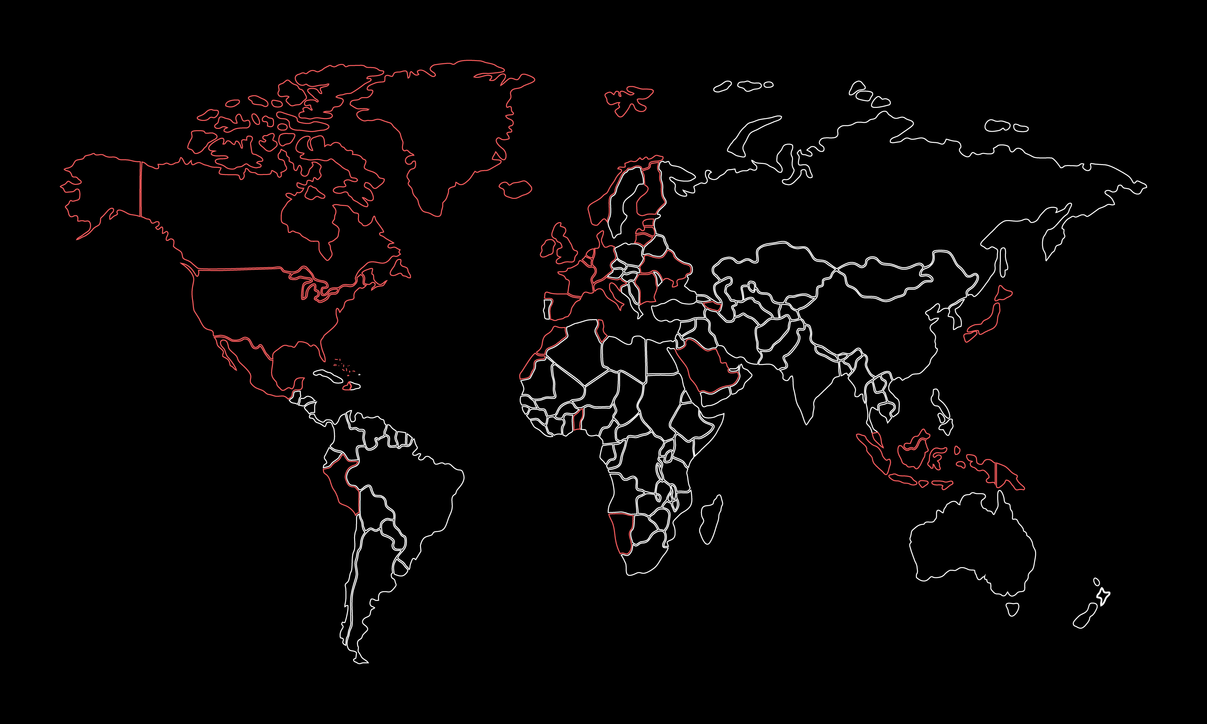
Clients in 35+ countries
USA
Malaysia
Tunisia
Ukraine
Japan
Benin
Greenland
Azerbaijan
Switzerland
Bahamas
Germany
and many more!

Slide 4
Architects of e-Estonia
Estonia is known as the world’s most advanced digital society.
Cybernetica has been a key partner in developing the world-renown e-governance solutions such as X-Road, SplitKey, e-Customs, Estfeed and more.

Slide 5
Architects of e-Estonia
1998
2000
2001
2004
2005
Time stamping
Digital Signature Act
X-Road
eCustoms for joining the EU
Internet voting

Slide 6
Architects of e-Estonia
2006
2009
2011
2014
2014
Sharemind pilot
Estonian blue border surveillance
Strategic alliance on crypto-graphic security
UXP secure data exchange
National GMDSS system

Slide 7
Architects of e-Estonia
2017
2018
2020
2022
2023
SplitKey mobile identity
Estfeed Smart Grid platform
Cyber threat intelligence platform between
Estonia
and US
Secure Digital Military Mobility
SplitKey CSP

Slide 8
Values
Integrity
Meaningful innovation
Resilient partnerships
Continuous learning
Accountability
Sustainability
Creating future technologies
Solutions with real impact
Top experts in the industry
Novel ways to execute
Turning customers into partners
Support throughout entire journey
We are delivery-oriented

Slide 9
Information Security Research Institute
Our accredited Research Institute focuses on information security, cooperating with both private and public sectors.
R&D partners include DARPA, ONR, EU Commission, EDF, ESA, Estonian Research Council and Enterprise Estonia.
R&D is in our DNA
40+ researchers
Contractual research
10+ PhDs
Publishing research publications
Consulting
Advanced projects
Teaching and training
Open source code
Product and technology development

Slide 10
Our research domains
Digital identity
Protocol research
Privacy and AI
Cybersecurity
Threshold cryptography
AI systems with end-to-end security
AI-based network anomaly detection
Internet voting
Zero knowledge proofs
Post-quantum cryptography
Synthetic data generation
Threat finding
Secure MPC protocols
Asset and threat management
Foundations of trust
Legal aspects of privacy tech

Slide 11
Solutions
Digital identity
Privacy enhancement
Interoperability
Tax and customs systems
Cybersecurity

Slide 12
Digital identity
Next generation smart phone based digital identity solution with unbreakable security.

Slide 13
A holistic digital identity value proposition
Technology
Product
Knowledge
Experience
Ongoing development of SplitKey provides hardware agnostic solutions in accordance with the highest regulatory standards.
Three different SplitKey products offering smartphone based digital identity technology for secure electronic signing and authentication.
Vast experience
with large scale projects at state level. Providing risk and security assessments, strategy and roadmaps as well as issuance procedures.
In depth knowledge of digital identity infrastructure through research projects with multi- national consultancy history.

Slide 14
Digital identity products
SplitKey
SplitKey+
SplitKey CSP
Consulting
Smartphone based digital identity technology for secure electronic signing and authentication.
In accordance with European Union regulation (eIDAS directive).
Consulting service to advise and analyse the current landscape and provide meaningful input for the digital transformation journey.
SplitKey for digital identity wallets to compliment the emerging European Union Digital Identity Wallet (EUDIW) ecosystem.
SplitKey with additional authentication methods for SplitKey – biometrics and pattern.

Slide 15
i-voting in Estonia
First election online held in 2005
Estonia is the first, and currently, the only state in the world where citizens can elect the government online
Local government units, state government and European Parliament
Over 50% of governmental election votes were cast online in 2023

Slide 16
Smart-ID
Baltics and Iceland
Digital identity technology is used all over the Baltics and Iceland in collaboration with the Smart-ID service operator.
3 million users and 75 million transactions per month
Used in services provided by top Nordic banks, leading telcos and e-commerce providers
80% of transactions originate from the financial sector

Slide 17
Partnerships
PwC – Middle East
Digital identity strategy for the Saudi Arabian Digital Government Agency
EY – North Africa and Estonia
Digital Transformation partnership and consulting with EY
iProov
Multi-Factor Authentication (MFA) digital identity solution for government and financial services organisations across the EMEA, LATAM, and APAC regions
Notes:
PWC:
Work on Technical Architecture, eID and Trust Services, Standards, and Legal chapters
EY
Providing expert analysis on Digital Identity Wallets for EU.

Slide 18
The Future: Digital Identity Wallets
SmartWallet
Collaboration with our partner SK ID Solutions to provide research and development on the wallet ecosystem and development of related solutions
Future Estonian Digital Identity Wallet (EDIW)
Collaboration with the EE Information System Authority, in designing the architecture of the future Estonian DIW and its compatibility with Estonia’s existing eID ecosystem

Slide 19
Collaboration with the Estonian Government
Estonian eID public key Single Point of Failure projects
CDOC 2.0 – new encryption protocol for ID
Internet Voting Mobile Client – mobile app to support i-Voting and m-Voting
Advisory on finding and implementing the best possible solution to bypass a possible security vulnerability with ID cards

Slide 20
Privacy and AI
Protect data from unauthorised processing.

Slide 21
Privacy-by-Design in AI systems
Sharemind MPC
Sharemind HI
Advisory
Data solutions
The Application Server provides an API for implementing privacy-preserving services using Trusted Execution Environments.
The next generation of data-driven services with end-to-end data protection and accountability.
+ Synthetic data
+ Differential privacy
+ Federated learning
+ Zero knowledge proofs
+ Impact assessments
+ Audits
+ Roadmaps and trainings

Slide 22
Interoperability
Trust-based data exchange technology to build scalable and secure digital ecosystems.

Slide 23
Interoperability offering
Unified eXchange Platform (UXP)
Managed UXP
UXP Data Privacy tools
Advisory
Full suite of consulting services to complement technical deployment, from capacity building to use-case discovery, and more.
Cloud-based Interoperability-as-a-Service solution where the whole process from implementation to maintenance is fully managed by Cybernetica.
Interoperability technology enabling peer-to-peer data exchange over encrypted and mutually authenticated channels.
Transparency-enhancing Access Tracking and Consent Management technologies for data protection compliance.

Slide 24
X-Road in Estonia
Estonian National Interoperability Framework
Technical architecture and implementation of Estonia’s data exchange platform X-Road
Underlying technology allowing to provide 99% of government services online
Over 3000 e-services available
Utilised by almost 600 enterprises and 150+ government institutions
Saving 1885 years of working time annually

Slide 25
UXP in Ukraine
National interoperability platform Trembita
Trembita supports Ukraine’s public service application Diia for e-services provision
Utilised by 201 state bodies
Over 300 services available
Solves the problem of long lines for state services and helps to increase the rate of efficiency and transparency
Reduced the number of state registers by two-thirds

Slide 26
UXP in Malaysia
Migrating the existing MyGDX platform to UXP
Highly scalable and secure interoperability technology for the Malaysian federal government
Facilitating data sharing and cooperation between government agencies
Ensuring that the information is accurate, up-to-date, and consistently managed by legitimate and authentic sources
Improving the performance of government service delivery

Slide 27
UXP in Benin
Full-scale interoperability platform in the Republic of Benin
Data exchange platform and National Citizen Portal were deployed in just 1 year
Over 40 government institutions connected
Over 250 e-services provided

Slide 28
Cybersecurity
Assessment, testing and advisory services for organisations who care about their real-world cybersecurity.

Slide 29
Cybersecurity offering
Cyber situational awareness (CSA)
Entity behaviour
Proactive cybersecurity services
Industrial cybersecurity
User and entity behaviour analysis in the networks to gain an understanding of the usage of a system and the actions within it.
Hybrid solutions of CSA solutions and entity behaviour applicable in industrial environments.
Cybersecurity solutions to elevate the awareness of cybersecurity matters.
Tailored services for organisations and institutions to elevate CSA.

Slide 30
Proactive cybersecurity services
Risk assessment
Tailored services
Analysis
Design
Implementation
Maintenance
Assessment of security and system architecture, risk management advisory.
Software composition analysis, secure system development support and more.
Systematic prevention measures incl. vulnerability scan, pentesting, threat audit and more.
Assessment of assets, business processes and critical systems.

Slide 31
ECYSAP
European operational platform for real-time cyber situational awareness
National and European security
Military operations
Monitoring and analytics of (potential) cyber threats
Simulation and prediction of threats

Slide 32
VORMSI
Cybersecurity threat sharing between Estonia and USA (USAFRL)
Research, design and implement standards, processes, methods and rules for the exchange and processing of cybersecurity information between nations
Goal is to improve joint cybersecurity awareness whilst ensuring national and regional expectations
Notes:
The project is named after an Estonian island Vormsi, pictured here with the famous lighthouse.

Slide 33
FAMOUS2
Next generation of interoperability for armoured vehicles
Maximise synergies, standardisation and interoperability of armoured vehicles
Study cybersecurity and threat intelligence needs
Design a cybersecurity management system:
Cybersecurity situational awareness
Threat intelligence channels
Incident handling procedures
Prototype and test the prototype’s functionality and security

Slide 34
EU-GUARDIAN
AI-based incident management solution
Accurate and reliable AI-based automation
Detect, mitigate and respond to incidents, semi-automatically or automatically
Enhance cyber situational awareness
Dynamically adapt strategy based on situation

Slide 35
Surveillance
Elevating situational awareness at sea through integrated border surveillance and vessel traffic management systems.

Slide 36
Future-proof technologies for safety at sea
Cybernetica provides maritime surveillance,
communication and vessel traffic management systems that are utilised in more than 100 locations worldwide spanning seas in Estonia, Europe, Africa and South-East Asia.
Integrated maritime surveillance
Vessel traffic management
Maritime radio communication

Slide 37
Surveillance systems offering
Border and maritime surveillance
Vessel traffic management
Coastal radio communication
Integrated surveillance systems for detecting, identifying, and monitoring objects on the mainland and blue borders.
TDoA integration.
Enhancing security of maritime and border environment, marine traffic awareness, and safety at sea.
+ Based on VoIP protocol, over IP network
+ System scalability

Slide 38
Maritime coastal radio communication system
Strait of Malacca
Deployment of complete radio system for Malaysia and Indonesia across both shores of the Strait
78+ localised operational stations to provide central control and supervision of system’s performance
Web-based marine traffic monitoring system and radio positioning features
Notes:
For major ports like the Port of Tanjung Priok, Semarang, Panjang, and Cirebon among others
Radio system includes: GMDSS, VHF, MF/HF
Web VTS and radio positioning features

Slide 39
Vessel traffic management system
Gibraltar Strait
Deployment of a comprehensive vessel traffic management system on the Gibraltar Strait – over 100 000 trade ships transit annually
Project completed within 3 years
Turn-key solution
Radar system
VHF and VHF aero radio system
Server infrastructure
Software for various databases and more
Notes:
Client: CSTM (Centre de Surveillance du Trafic Maritime), Morocco
Delivered as a turn-key solution with Cybernetica being the prime contractor and integrator.
The complete delivery consisted of:
a radar system;
AIS system;
MF/HF, VHF and VHF aero radio systems;
server infrastructure; new radio link system for data transmission;
LAN and equipment;
back-up power supply and refurbishment of the existing;
monitoring system;
operator station with furniture and consoles;
antennas;
software for VTS, radio, vessel database, monitoring, GIBREP mandatory reporting;
services, including: installation of the new equipment and de-installation of the existing, training, transition support, civil works, new electrical system, cabling, refurbishment of existing towers and site infrastructure;
legacy system integration, including: old radar for triple redundancy, SAR module, weather stations, RDF for radio positioning.

Slide 40
Border and maritime surveillance
EU and NATO external border
Strengthening the surveillance capabilities on the EU and NATO external border
Cohesive surveillance ecosystem to raise situational awareness
Integrated system of radars, cameras and other surveillance equipment
Over 200 localised stations within the Eastern border of Estonia, part of the EU and NATO external border, including Romania
Notes:
Sensorparks/assets/data transmission/operator network, surface vs air monitoring, Drones

Slide 41
Tax and customs systems
Turn-key software solutions for tax and customs based on decades-long expertise.

Slide 42
Tax and customs systems offering
Software development
Advisory
We have cooperated with the Estonian Tax and Customs board since 2003.
Our expertise played an integral role upon admission to the EU in 2004.
Custom software for all tax and customs matters: import, export, transit, VAT, excise and more.
Full compliance with EU specifications.

Slide 43
Estonian Tax and Customs Board
Strategic partner to the Estonian Tax and Customs Board since 2003
Import/export system Complex2
Development partner since 2003
Transit system NCTS
Excise tax management system EMCS
Development partner since 2009
VAT tax management system KMD
Development partner since 2009

Slide 44
Thank you.

